Slide 1
Lesson 12 The transfiguration
August 19, 2020
Stumbling Blocks
Matthew 18:1-14; Mark 9:33-50; Luke 9:46-50

Slide 2
True greatness and stumbling Blocks Matthew 18:1-14; Mark 9:33-50; Luke 9:46-50
Mark 9:42-50 – Stumbling blocks to others
“Whoever causes one of these little ones who believe to stumble …”
“These little ones …” – Those who His apostles wanted sent away – young, growing disciples.
“Stumble” – again from the Greek skandalizo meaning “to trip up” (Strong); “an impediment in the way” (Thayer)
Notes:
“Stumble” - lead astray, lead into sin. (Zodhiates)
How can we be a stumbling block to a young, growing new creature in Christ? Acts 26:22; Rev. 11:18; 13:16; 19:18; 20:12, “the small and the great”. Rev. 3:8, You have a little power/strength.

Slide 3
True greatness and stumbling Blocks Matthew 18:1-14; Mark 9:33-50; Luke 9:46-50
Key words in this context:
“It would be better …” (Matthew 18:6; cf. Matthew 5:29-30; 7:11). A comparative expression.
For someone who causes a “little one … to stumble” to have a “heavy millstone hung around his neck” and “cast into the sea.” (Mark 9:42)
Notes:
Causing another to sin is so horrible, dying a horrible death would be the best thing for such a person.
A death sentence! Why?

Slide 4
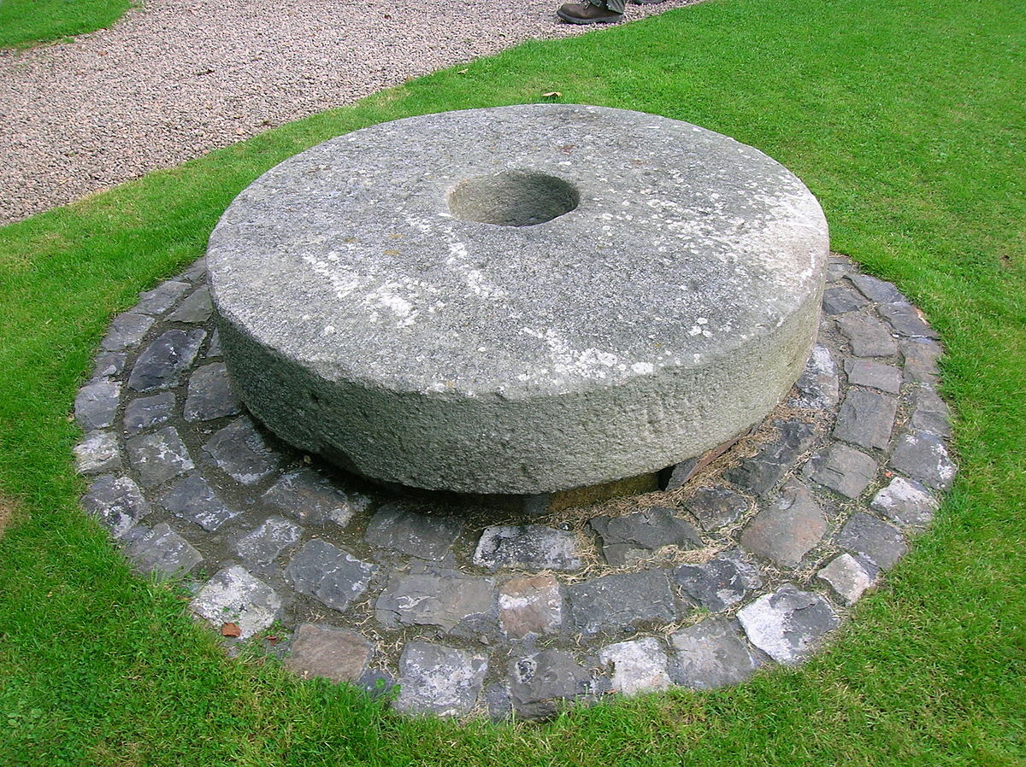
True greatness & stumbling Blocks Matthew 18:1-14; Mark 9:33-50; Luke 9:46-50

Slide 5
True greatness and stumbling Blocks Matthew 18:1-14; Mark 9:33-50; Luke 9:46-50
“Woe to the world because of its stumbling blocks! For it is inevitable that stumbling blocks come; but woe to that man through whom the stumbling block comes.” (Matthew 18:7)
Some obvious like Balaam. (Numbers 31:16; Revelation 2:14; cf. Proverbs 4:16)
Others come through negligence and carelessness. Intentions do not matter!
How do we prevent either? (Proverbs 3:23; Psalms 119:162-165; 1 John 2:10)
Notes:
Prov 4:14-16
aDo not enter the path of the wicked
And do not proceed in the way of evil men.
15 Avoid it, do not pass by it;
Turn away from it and pass on.
16 For they cannot sleep unless they do evil;
And they are robbed of sleep unless they make someone stumble.
Prov 3:21-26
My son, let them not vanish from your sight ;Keep sound wisdom and discretion, 22 So they will be life to your soul And adornment to your neck. 23 Then you will walk in your way securely And your foot will not stumble. 24 When you lie down, you will not be afraid; When you lie down, your sleep will be sweet. 25 Do not be afraid of sudden fear Nor of the onslaught of the wicked when it comes; 26 For the Lord will be your confidence And will keep your foot from being caught.
Prov 24:16
6 For a righteous man falls seven times, and rises again, But the wicked stumble in time of calamity.

Slide 6
True greatness and stumbling Blocks Matthew 18:1-14; Mark 9:33-50; Luke 9:46-50
Stumbling blocks to self: (Mark 9:43-48)
“If your hand causes you to stumble, cut it off …”
Anything you do.
“If your foot causes you to stumble, cut if off …”
Anywhere you go.
“If your eye causes you to stumble, throw it out …”
Anything you look at.
Notes:
Watch out for the leeches in your life!
Reminds me of the childrens song: O be careful little eyes what you see; O be careful little hands what you do; O be careful little feet where you go

Slide 7
True greatness and stumbling Blocks Matthew 18:1-14; Mark 9:33-50; Luke 9:46-50
How can we prove to be a stumbling block to others?
Commission/omission AND tolerance of sin. (1 Corinthians 5:1-11; 6:9-11; James 4:17)
False teaching (Malachi 2:8; 2 Peter 2:1-3)
Hypocrisy. (Galatians 2:13; Luke 12:1)
Use of “liberties” (1 Corinthians 8:9, 13)
Half-heartedness. (1 Chronicles 28:9; 1 Kings 8:61; 11:4; 15:3; Mark 12:30)
Carnally focused. (1 Corinthians 2:14; Romans 8:6-8)
Notes:
Watch out for the leeches in your life!
Reminds me of the childrens song: O be careful little eyes what you see; O be careful little hands what you do; O be careful little feet where you go

Slide 8
True greatness and stumbling Blocks Matthew 18:1-14; Mark 9:33-50; Luke 9:46-50
Unhealthy influences (Ezekiel 14:3-4; Psalms 101:3)
Distracted living. (Luke 10:38-42; Mark 4:19)
Lack of effort. (1 Corinthians 9:24)
Spiritual drifting. (Hebrews 2:1-2)
Lack of growth. (2 Peter 3:17; Hebrews 5:12)
Failing to flee temptation. (1 Corinthians 10:12)
Notes:
Watch out for the leeches in your life!
Walk circumspectly! (Ephesians 5:15)

Slide 9
True greatness and stumbling Blocks Matthew 18:1-14; Mark 9:33-50; Luke 9:46-50
Rid your life of anything, anywhere, or anyone that is keeping you from running your race with endurance. (cf. Hebrews 12:1-2)
Again, the comparison is made, “It is better … to enter life crippled … lame … with one eye … than to be cast into hell … where their worm does not die, and the fire is not quenched.”
Notes:
Hell - Gehenna - Valley of Hinnom. The references to the worm and the fire speaking to the actual valley of Hinnom.
where filth and debris are continually infested with worms and maggots. There the worms never cease to exist and the fire is never extinguished, an apt description of eternal or unceasing punishment in the pain and torment of the lake that burns
with fire and brimstone (see Matt. 25:41, 46; 2 Thess. 1:7-9; Rev. 14:11; 21:8). Here Jesus alludes to, but does not state directly, the
doctrine of eternal punishment. (Truth Commentary)
Watch out for the leeches in your life!
Reminds me of the childrens song: O be careful little eyes what you see; O be careful little hands what you do; O be careful little feet where you go

Slide 10
True greatness and stumbling Blocks Matthew 18:1-14; Mark 9:33-50; Luke 9:46-50
Again, the focus is on purity of heart rather than the flesh.
Matthew 5:27-30 stresses to make such sacrifices for the sake of your heart.
The key is to change our thinking.
Cutting off one’s hand or foot fails to address the root of the problem … the heart.
Notes:
Hell - Gehenna - Valley of Hinnom. The references to the worm and the fire speaking to the actual valley of Hinnom.
where filth and debris are continually infested with worms and maggots. There the worms never cease to exist and the fire is never extinguished, an apt description of eternal or unceasing punishment in the pain and torment of the lake that burns
with fire and brimstone (see Matt. 25:41, 46; 2 Thess. 1:7-9; Rev. 14:11; 21:8). Here Jesus alludes to, but does not state directly, the
doctrine of eternal punishment. (Truth Commentary)
Watch out for the leeches in your life!
Reminds me of the childrens song: O be careful little eyes what you see; O be careful little hands what you do; O be careful little feet where you go

